Slide 1


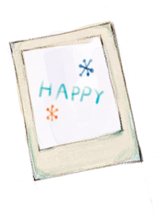


MINOR PROJECT
OBSTACLE DETECTOR USING ULTRASONIC
SENSOR
6th Semester
2018 Admitted Batch
ELECTRICAL AND ELECTRONICS ENGINEERING
School of Electronics Engineering
Kalinga Institute of Industrial Technology, Deemed to be University Bhubaneswar, India 2021
GROUP MEMBERS
1807258 | Ashish
1807259 | Ashutosh Yadav
1807265 | B.Dheeraj Chandan
1807266 | Biswayan Banerjee
1807292 | P. Sai Manohar

Slide 2

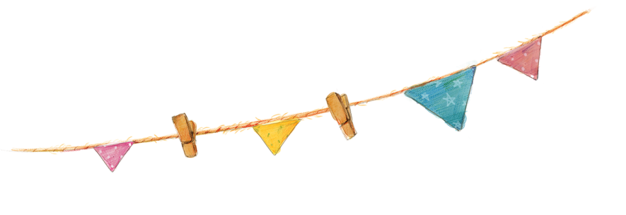
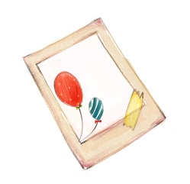
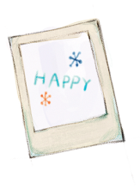
Contents
01
Group Members
02
Introduction
03
Components & Software
04
Working & Coding
05
Conclusion

Slide 3
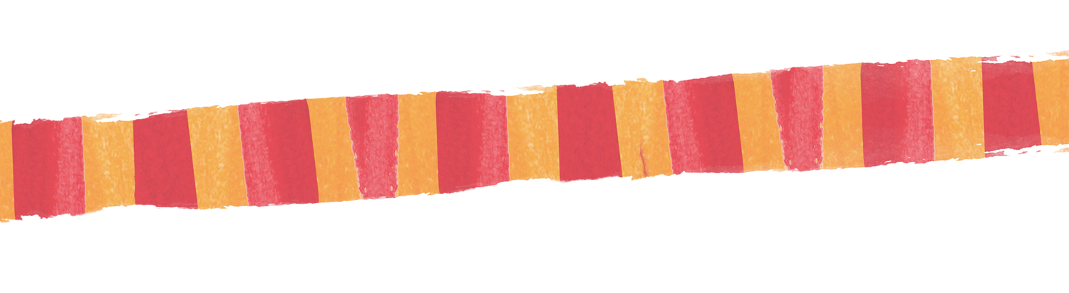

Under the guidance of :
Prof. R.K Khanna
1807258 | Ashish
1807259 | Ashutosh Yadav
1807265 | B.Dheeraj Chandan
1807266 | Biswayan Banerjee
1807292 | P. Sai Manohar

Slide 4
02
Introduction
OBSTACLE DETECTOR USING ULTRASONIC SENSOR
Obstacle detection is a process where we combined the sensor with algorithm to detect any obstacle
coming in patway of the sensor. Here we are focusing in automobile sector.
We generally use the Ultrasonic sensor for the sensing purpose of obstacle, as they come under the
list of Proximity sensor( no physical contact), and are less expensive.
Ultrasonic sensors are the device which work on electrical-mechanical wave conversion to detect
the obstacle. It transmit the longitudinal waves at particular interval of time and comes under active
method of doing it.
The use of sensor is in economic range compared to computer vision and LIDAR system. We have
added a buzzer with a LED for the alert purpose if distance reaches to collision factor.

Slide 5
03
Components & Software Required for
operating :
Electronic components :
Arduino UNO R3 board
Ultrasonic Sensor
Bread Board
Potentiometer
Jump wires
LCD Screen
Buzzer
Software :
Arduino IDE
Proteus Design Suite

Slide 6
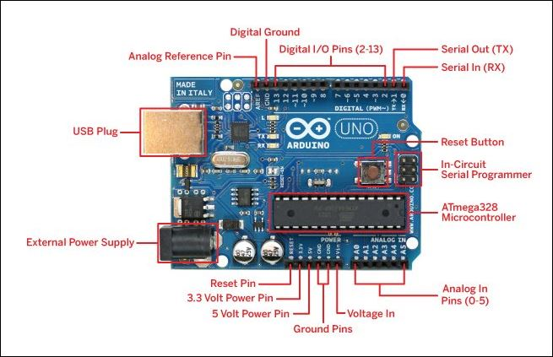
ARDUINO UNO R3
The Arduino Uno R3 is a microcontroller board based a removable,
dual-inline-package (DIP) ATmega328 AVR microcontroller.
Arduino Uno is a open source microcontroller board.
It has 14 digital input/output pins(of which 6 can be used as PWM
outputs), 6 analog inputs,16 MHz ceramic resonator, USB connection,
a powerjack, an ICSP header and a reset button.
It has a 8 bit RISC(reduce instruction set) processor core.

Slide 7
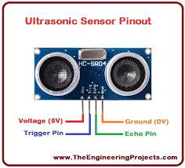
HC-SR04 ULTRASONIC SENSOR
HC-SR04 ultrasonic sensor also a Proximity sensor detect the presence of an object without
making physical contact just like SONAR. It consists of two transducer one act as a transmitter
transmitting sound waves, of 40Khz at regular intervals and other as receiver which receive the
reflected transmitted waves.
They are the low powered, inexpensive and easy to interface.
It has 4 pins: Vcc , Trig , Echo and GND with specifications--

Slide 8
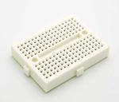
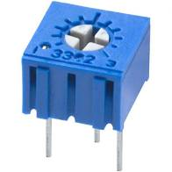
BREAD BOARD
A breadboard is a solderless device for temporary prototype with
electronics and test circuit designs.
Most of the electronic components can be interconnected by
inserting their leads or terminals into the holes and then making
connections through jump wires.
POTENTIOMETER
A Trimpot (10K) potentiometer is a small potentiometer which
is used for adjustment, tuning and calibration in circuits.
Here we are using to control display of LCD screen.

Slide 9
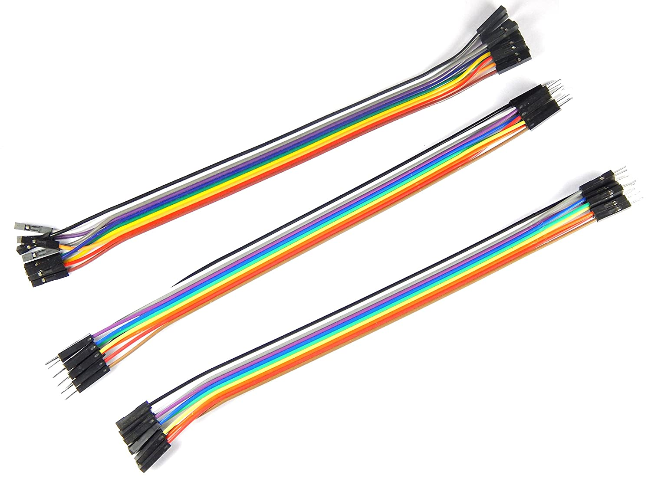
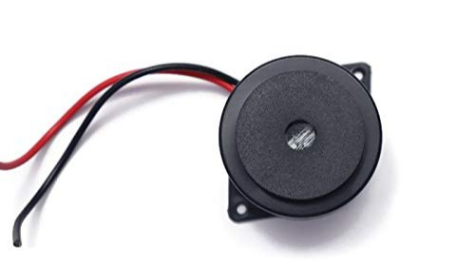
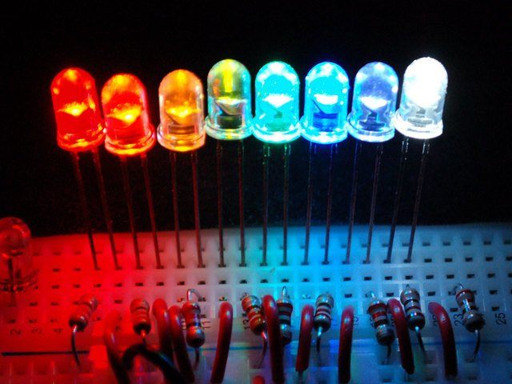
JUMP WIRES
Connecting wires are also known as Jumper wires or patch cords.
Jumper wires are typically used with breadboards and other
prototyping tools in order to make it easy to change a circuit as
needed.
BUZZER
Buzzer or a beeper is an audio signaling
device can be electrical,electrocmechanical etc.
LED
A light-emitting diode (LED) is a semiconductor light source that emits light when current flows through it.

Slide 10
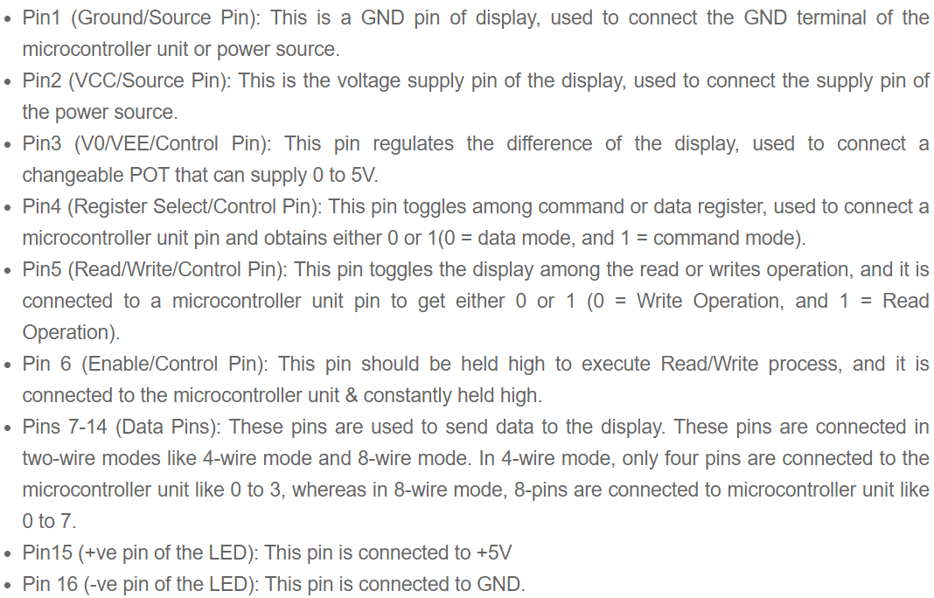
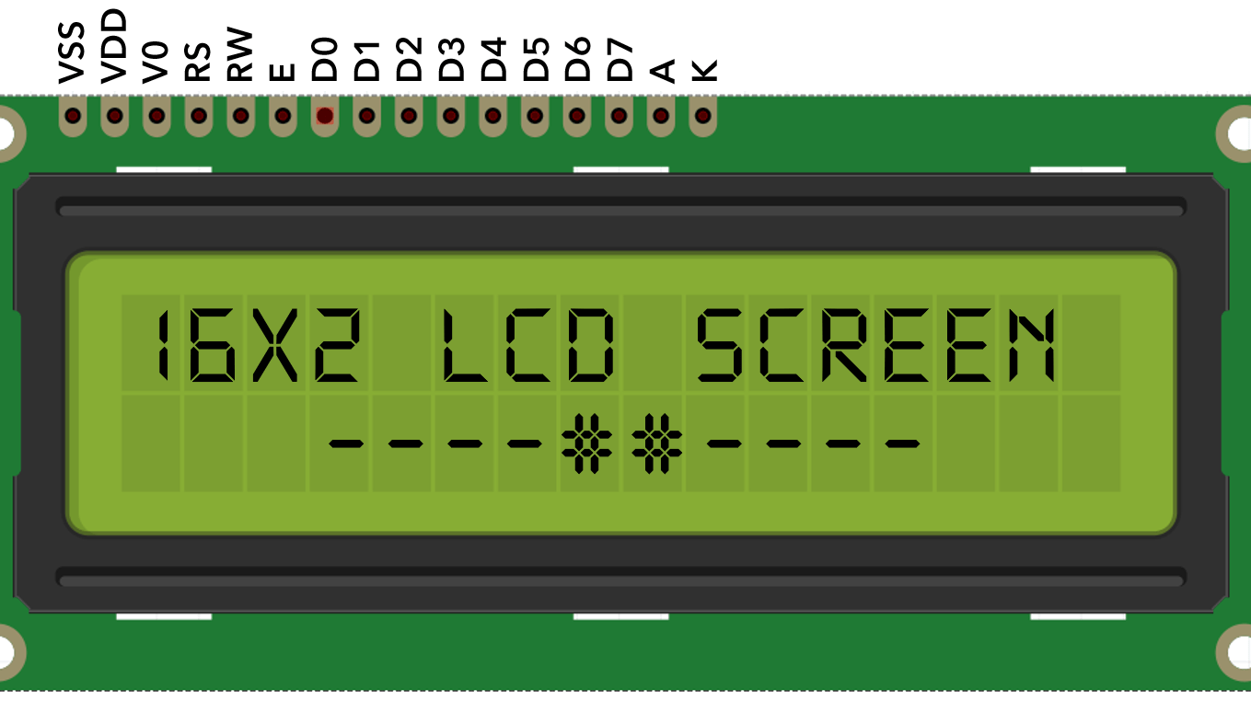
Screen LCD
LCD also known as Liquid-Crystal Display.
It has 16 pins: Vss, Vdd, Vo, Rs, Rw, E, Digital pins(D0-D7),
A(anode), K(cathode).

Slide 11
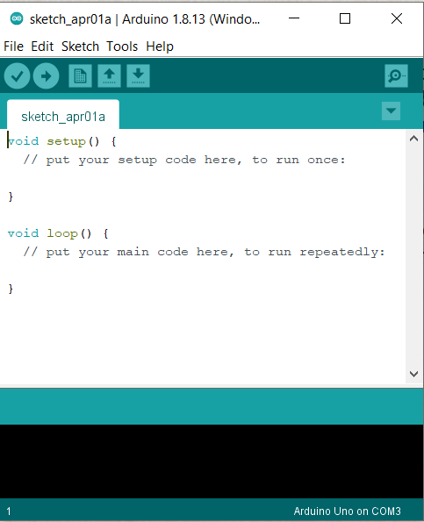
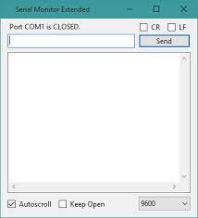
ARDUINO IDE
The Arduino integrated development (IDE) is an application that is
deployed across platforms like Windows, mac OS and UNIX
operating system, Java being the artificial language.
It is used to write and transfer programs to Arduino compatible boards.
The languages supported by the Arduino IDE primarily C and C++ ,
additionally to that special rules of code structuring i.e compatible.

Slide 12
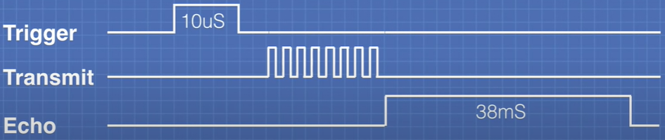
04
Working
To generate ultrasonic waves from sensor we set the Trigger pin on a HIGH state for “10μS” of time , which then transmit “8” cycle of ultrasonic pulse 40KHz each at regular interval of time and at a
speed of sound. If there is obstacle detected in path of waves then the ultrasonic waves get reflected
back to the Echo terminal of the sensor.
If there is no obstacle found in the waves direction then Echo pin has timeout of “38mS” to sence any
reflected ultrasonic waves to give any output.

Slide 13

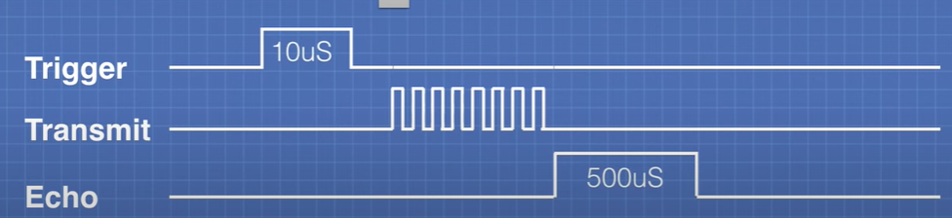
If there is obstacle detected in the waves direction then Echo pin is found out to have some values.
Time taken by the reflected ultrasonic waves to reach sensor helps to determine the distance of the
obstacle.
By the formula of:-
Ultrasonic signal travell’s at speed of sound therefore at room temperature (20°C) speed of waves is
“343m/s” or “0.0343cm/μS”.
ex: if time taken by the reflected waves to reach sensor is “500μS” then distance of obstacle --
distance=(500/2)*0.0343
=8.575cm
* we have fixed the range in prototype to 10 cm for convenience.

Slide 14
Connection’s
ARDUINO:
Code has been installed in the board.
LCD:
following connection done for lcd-
Vss with GND pin of Arduino UNO board
Vdd with +5 volts.
Vo with middle pin of potentiometer
RS with digital pin 12 of Arduino UNO board
RW with GND pin of Arduino UNO board
E with digital pin 11 of Arduino UNO board
D4 with digital pin 5 of Arduino UNO board
D5 with digital pin 4 of Arduino UNO board
D6 with digital pin 3 of Arduino UNO board
D7 with digital pin 2 of Arduino UNO board
A with +5 volts
K with ground pin of Arduino UNO board

Slide 15
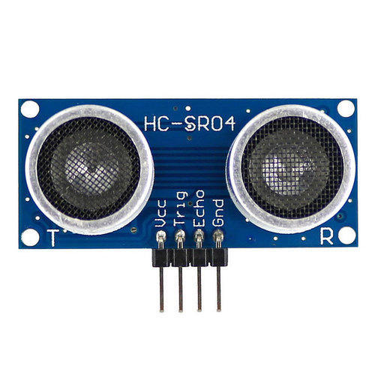
HC-SRO4 SENSOR:
Vcc pin with +5 volts
Trigger pin with with digital pin 13 of Arduino UNO board
Echopin with with digital pin 8 of Arduino UNO board
GND pin with GND pin of Arduino UNO board
POTENTIOMETER:
Left pin with +5 volt supply
Middle pin with LCD PIN V0
Right pin with GND pin of Arduino UNO board
BUZZER:
Positive terminal to pin 13 of Arduino
Negative terminal to GND
LED:
Positive terminal to pin 13 of Arduino
Negative terminal to GND

Slide 16
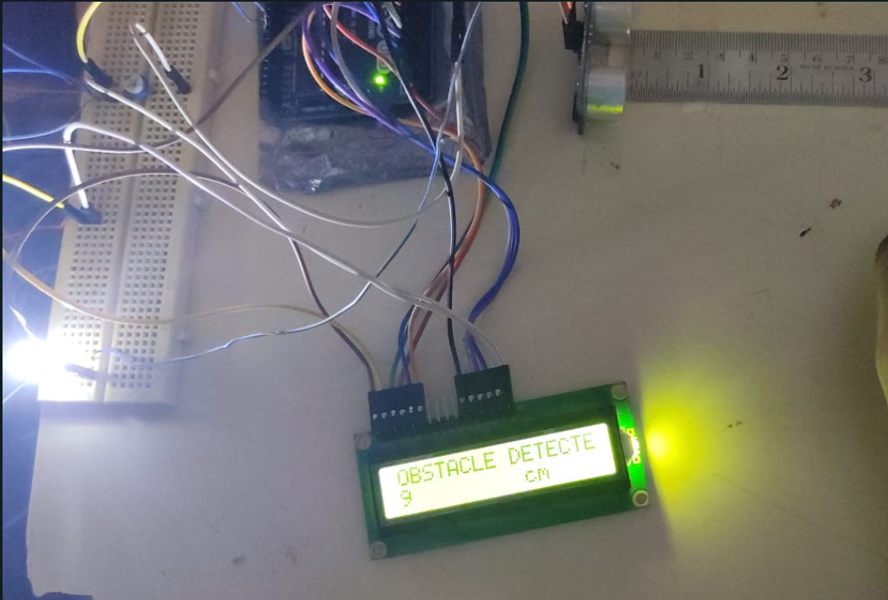
Setup

Slide 17
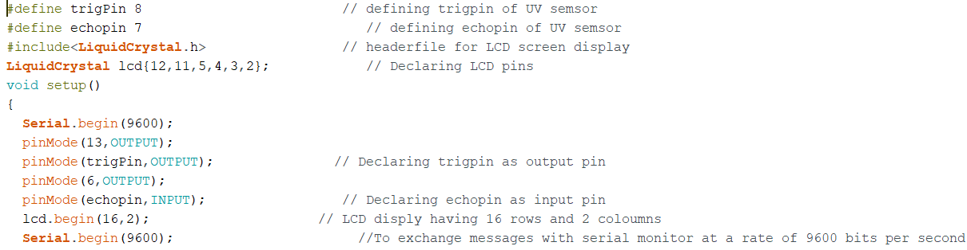
Coding

Slide 18
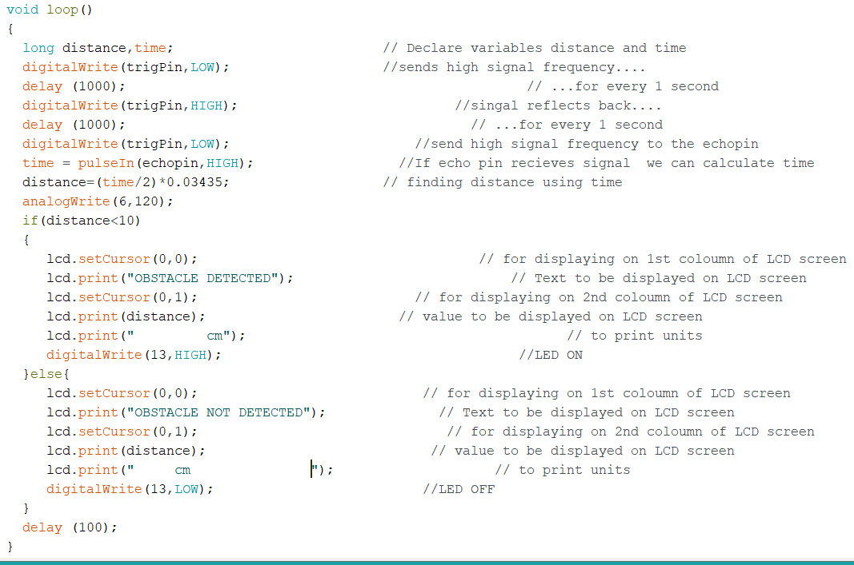

Slide 19
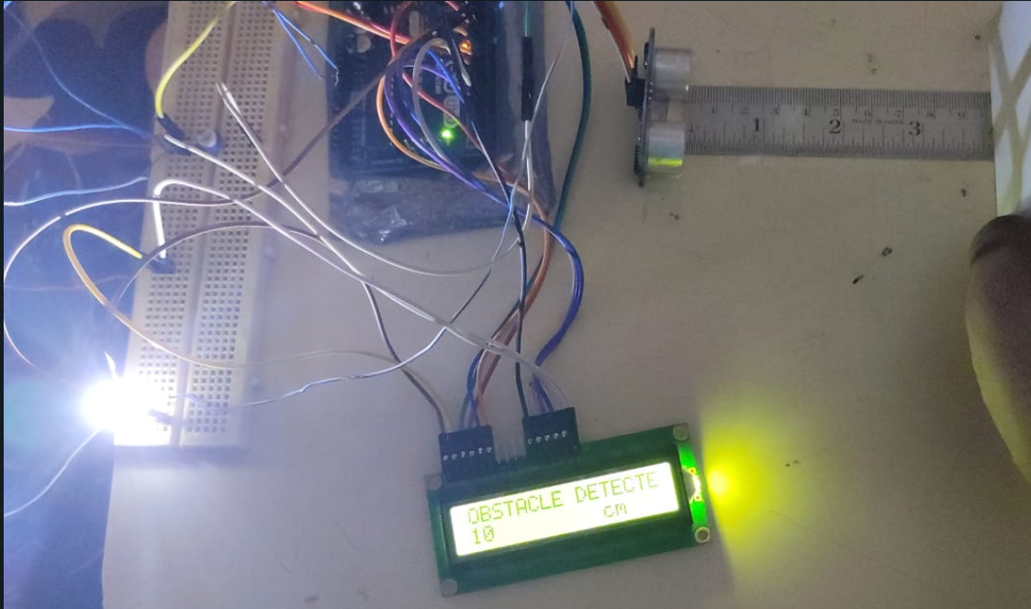
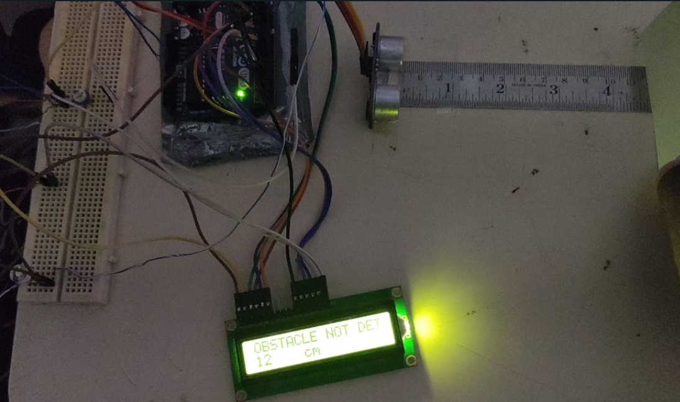
PROTOTYPE RESULT
* we have fixed the range in simulation to 10cm for convenience

Slide 20
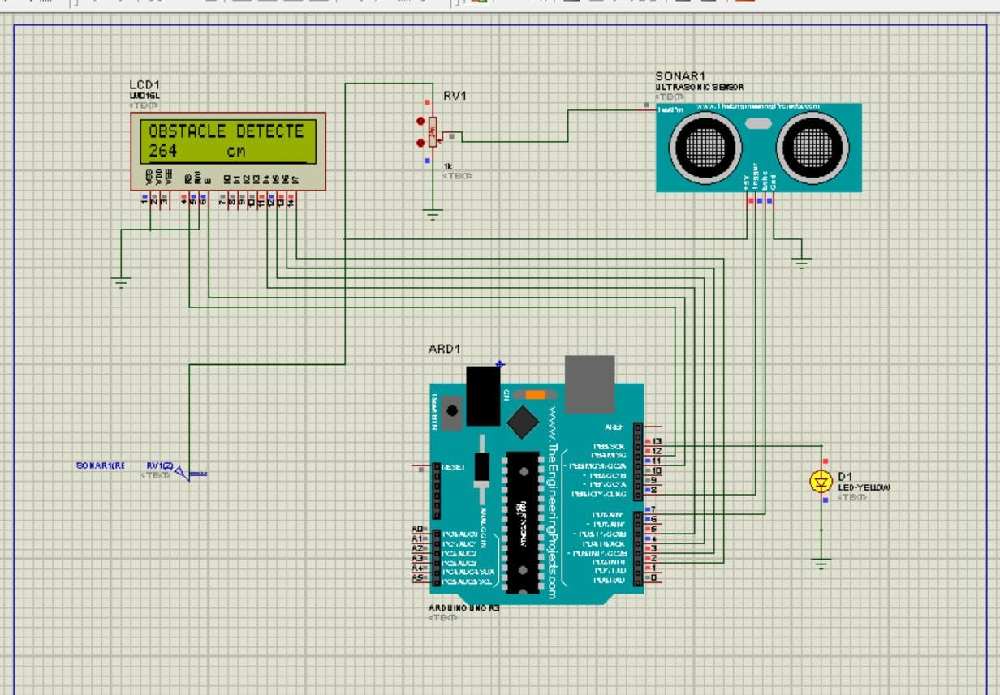
PROTEUS simulation platform
Simulation platform for simulating the project used here is “PROTEUS”.
Its a software tool suite used primarily for electronic design automation.

Slide 21
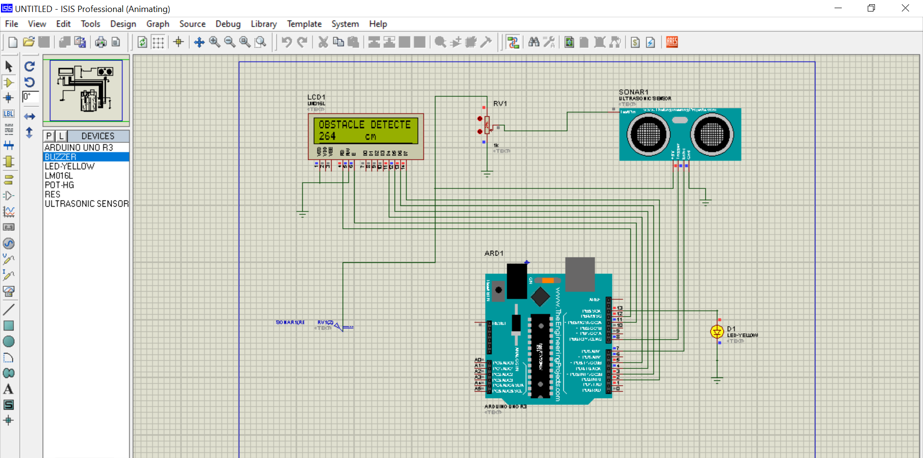

PROTEUS simulation Result
* we have fixed the range in simulation to 300 cm for convenience

Slide 22
05
Conclusion
The goal of our project was to learn the implementation of obstacle detector as a whole in a system with the help of ardunio algorithm. We also get a experience on Proteus
electronic design suite app.
Future scope:-
Alert parking system in cars, or the self driving cars has a major advantage
from the system.
It can be used to improve the braking system of automobile preventing accidents.
It can be used a improve in the mobility as well as safety of visually impaired people
specially in unfamiliar environment.
At a economic level this can be helpfull in home security as a warning of intruder.

Slide 23
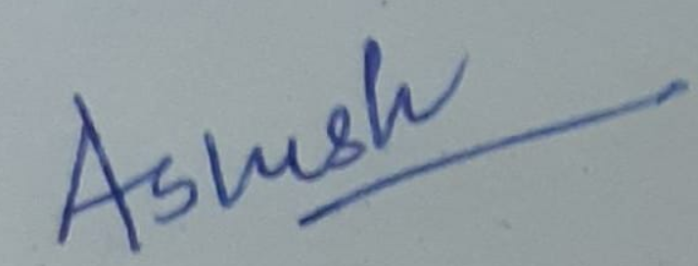


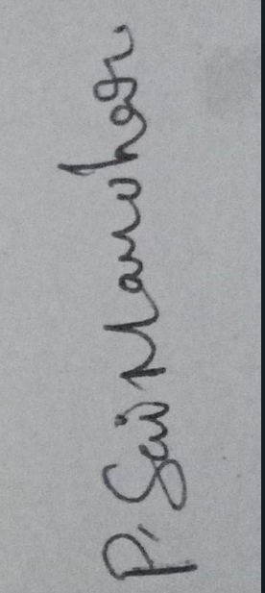
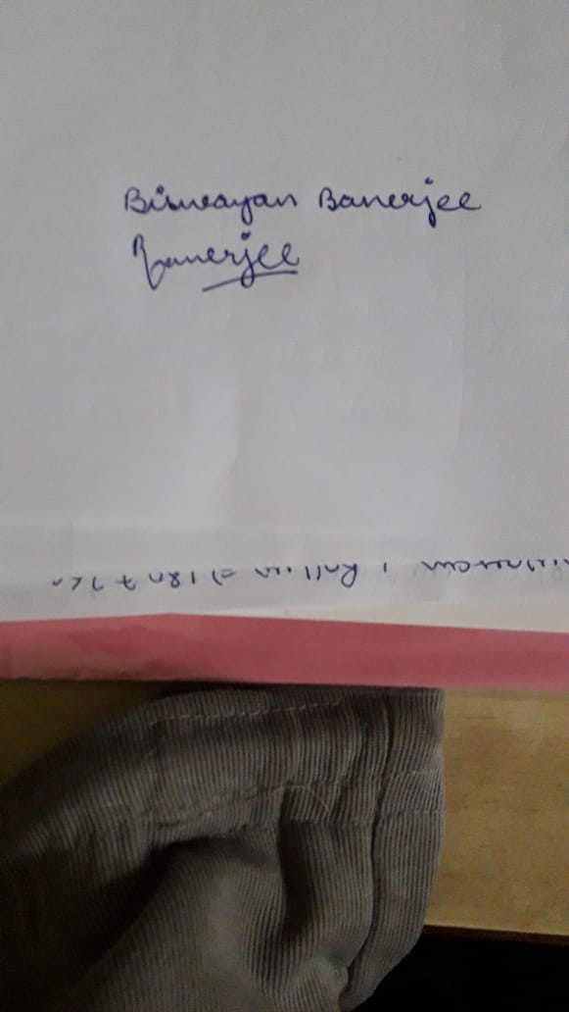
THANK YOU
1807258 | Ashish
1807259 | Ashutosh Yadav
1807265 | B.Dheeraj Chandan
1807266 | Biswayan Banerjee
1807292 | P. Sai Manohar

